Slide 1
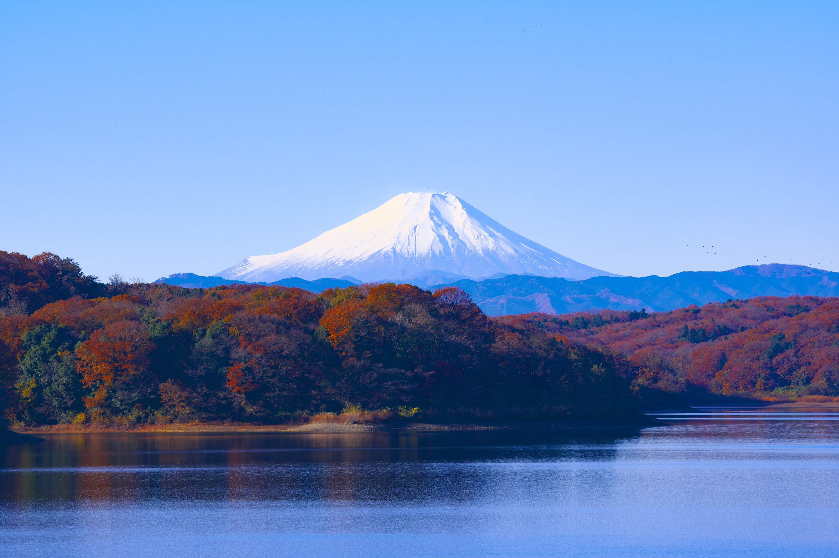
JAPAN

Slide 2



JAPAN
Mount Fuji
Mount Fuji, Japanese Fuji-san, also spelled Fujisan, also called Fujiyama or Fuji no Yama, highest mountain in Japan. It rises to 12,388 feet (3,776 metres) near the Pacific Ocean coast
3776 m
Yamanaka
Lake
7,00,000
Y.A

Slide 3
JAPAN
Mount Fuji
Mount Fuji, Japanese Fuji-san, also spelled Fujisan, also called Fujiyama or Fuji no Yama, highest mountain in Japan. It rises to 12,388 feet (3,776 metres) near the Pacific Ocean coast
Yamanaka
Lake
3776 m
7,00,000
Y.A

Slide 4
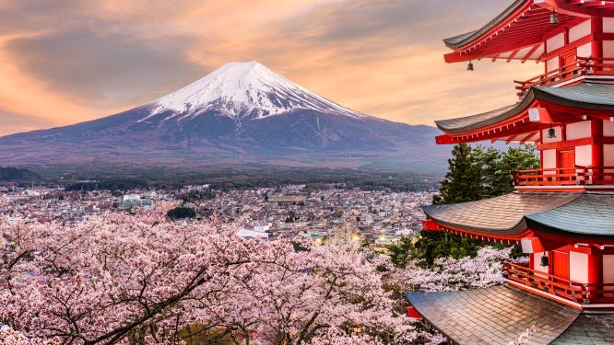
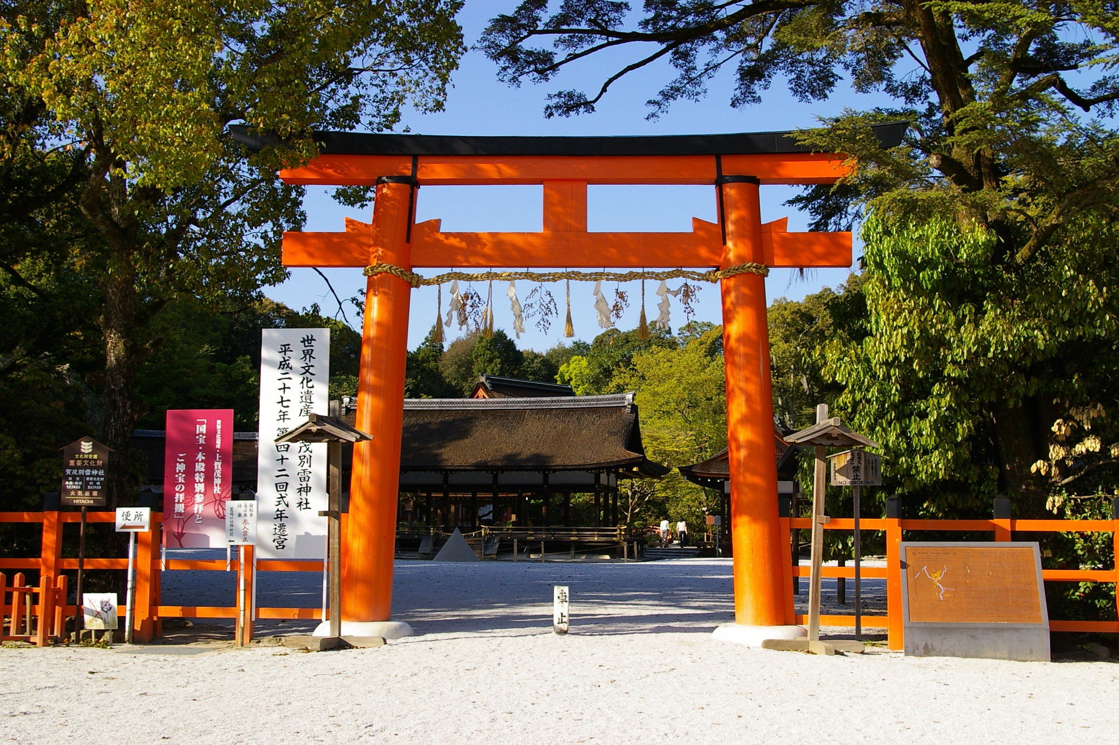
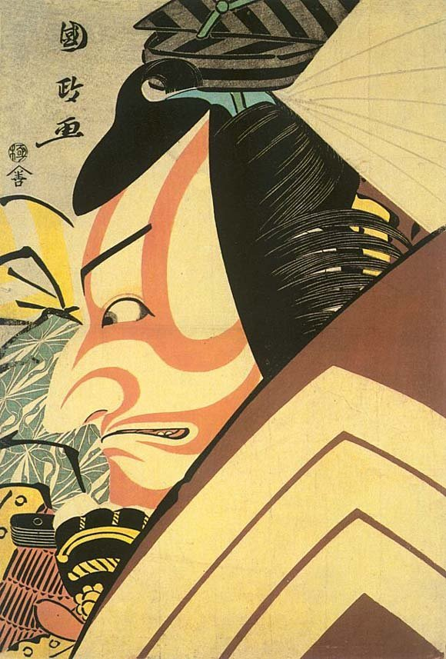
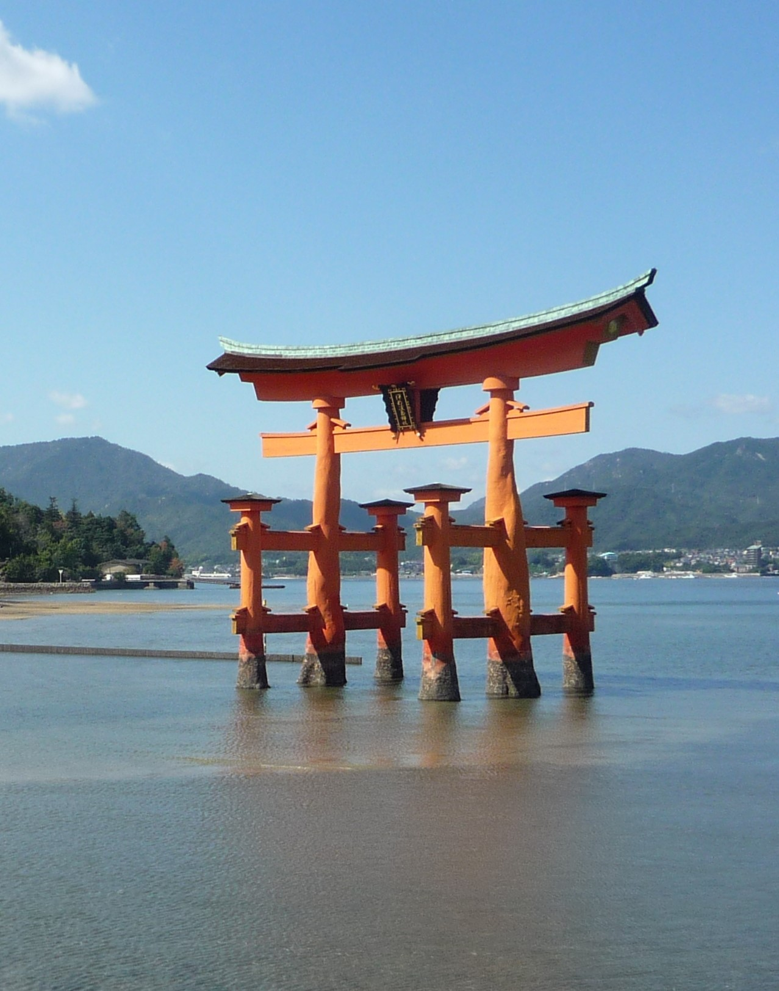
JAPAN
Mount Fuji
Mount Fuji, Japanese Fuji-san, also spelled Fujisan, also called Fujiyama or Fuji no Yama, highest mountain in Japan. It rises to 12,388 feet (3,776 metres) near the Pacific Ocean coast
Yamanaka
Lake
3776 m
7,00,000
Y.A
VISUAL ART
JAPANESE CULTURE
RELIGION
LANDSCAPE
Shinto and Buddhism are the primary religions of Japan. According to the annual statistical research on religion in 2018 by the Government of Japan's Agency for Culture Affairs, 66.7 percent of the population
Painting has been an art in Japan for a very long time: the brush is a traditional writing and painting tool, and the extension of that to its use as an artist's tool was probably natural. Japanese painters are often categorized by what they painted, as most of them constrained themselves solely to subjects such as animals, landscapes, or figures.
There are 51 official cultural landscapes , bunkmate Keilan) in Japan. These landscapes evolved with the way of life and ecocultural features of a region, and which are indispensable for understanding the lifestyle of the Japanese people.

Slide 5
JAPAN
Mount Fuji
Mount Fuji, Japanese Fuji-san, also spelled Fujisan, also called Fujiyama or Fuji no Yama, highest mountain in Japan. It rises to 12,388 feet (3,776 metres) near the Pacific Ocean coast
Yamanaka
Lake
3776 m
7,00,000
Y.A
VISUAL ART
JAPANESE CULTURE
RELIGION
LANDSCAPE
Shinto and Buddhism are the primary religions of Japan. According to the annual statistical research on religion in 2018 by the Government of Japan's Agency for Culture Affairs, 66.7 percent of the population
Painting has been an art in Japan for a very long time: the brush is a traditional writing and painting tool, and the extension of that to its use as an artist's tool was probably natural. Japanese painters are often categorized by what they painted, as most of them constrained themselves solely to subjects such as animals, landscapes, or figures.
There are 51 official cultural landscapes , bunkmate Keilan) in Japan. These landscapes evolved with the way of life and ecocultural features of a region, and which are indispensable for understanding the lifestyle of the Japanese people.

Slide 6
JAPAN
Mount Fuji
Mount Fuji, Japanese Fuji-san, also spelled Fujisan, also called Fujiyama or Fuji no Yama, highest mountain in Japan. It rises to 12,388 feet (3,776 metres) near the Pacific Ocean coast
Yamanaka
Lake
3776 m
7,00,000
Y.A
JAPANESE CULTURE
VISUAL ART
RELIGION
LANDSCAPE
Painting has been an art in Japan for a very long time: the brush is a traditional writing and painting tool, and the extension of that to its use as an artist's tool was probably natural. Japanese painters are often categorized by what they painted, as most of them constrained themselves solely to subjects such as animals, landscapes, or figures.
Shinto and Buddhism are the primary religions of Japan. According to the annual statistical research on religion in 2018 by the Government of Japan's Agency for Culture Affairs, 66.7 percent of the population
There are 51 official cultural landscapes , bunkmate Keilan) in Japan. These landscapes evolved with the way of life and ecocultural features of a region, and which are indispensable for understanding the lifestyle of the Japanese people.

Slide 7
JAPAN
Mount Fuji
Mount Fuji, Japanese Fuji-san, also spelled Fujisan, also called Fujiyama or Fuji no Yama, highest mountain in Japan. It rises to 12,388 feet (3,776 metres) near the Pacific Ocean coast
Yamanaka
Lake
3776 m
7,00,000
Y.A
JAPANESE CULTURE
LANDSCAPE
RELIGION
VISUAL ART
There are 51 official cultural landscapes , bunkmate Keilan) in Japan. These landscapes evolved with the way of life and ecocultural features of a region, and which are indispensable for understanding the lifestyle of the Japanese people.
Painting has been an art in Japan for a very long time: the brush is a traditional writing and painting tool, and the extension of that to its use as an artist's tool was probably natural. Japanese painters are often categorized by what they painted, as most of them constrained themselves solely to subjects such as animals, landscapes, or figures.
Shinto and Buddhism are the primary religions of Japan. According to the annual statistical research on religion in 2018 by the Government of Japan's Agency for Culture Affairs, 66.7 percent of the population

Slide 8
JAPAN
Mount Fuji
Mount Fuji, Japanese Fuji-san, also spelled Fujisan, also called Fujiyama or Fuji no Yama, highest mountain in Japan. It rises to 12,388 feet (3,776 metres) near the Pacific Ocean coast
Yamanaka
Lake
3776 m
7,00,000
Y.A
JAPANESE CULTURE
RELIGION
VISUAL ART
LANDSCAPE
Painting has been an art in Japan for a very long time: the brush is a traditional writing and painting tool, and the extension of that to its use as an artist's tool was probably natural. Japanese painters are often categorized by what they painted, as most of them constrained themselves solely to subjects such as animals, landscapes, or figures.
There are 51 official cultural landscapes , bunkmate Keilan) in Japan. These landscapes evolved with the way of life and ecocultural features of a region, and which are indispensable for understanding the lifestyle of the Japanese people.
Shinto and Buddhism are the primary religions of Japan. According to the annual statistical research on religion in 2018 by the Government of Japan's Agency for Culture Affairs, 66.7 percent of the population

Slide 9
JAPAN
Mount Fuji
Mount Fuji, Japanese Fuji-san, also spelled Fujisan, also called Fujiyama or Fuji no Yama, highest mountain in Japan. It rises to 12,388 feet (3,776 metres) near the Pacific Ocean coast
Yamanaka
Lake
3776 m
7,00,000
Y.A
Thanks For Watching
JAPANESE CULTURE
RELIGION
Painting has been an art in Japan for a very long time: the brush is a traditional writing and painting tool, and the extension of that to its use as an artist's tool was probably natural. Japanese painters are often categorized by what they painted, as most of them constrained themselves solely to subjects such as animals, landscapes, or figures.
LANDSCAPE
There are 51 official cultural landscapes , bunkmate Keilan) in Japan. These landscapes evolved with the way of life and ecocultural features of a region, and which are indispensable for understanding the lifestyle of the Japanese people.
VISUAL ART
Shinto and Buddhism are the primary religions of Japan. According to the annual statistical research on religion in 2018 by the Government of Japan's Agency for Culture Affairs, 66.7 percent of the population

Slide 10
JAPAN
Mount Fuji
Mount Fuji, Japanese Fuji-san, also spelled Fujisan, also called Fujiyama or Fuji no Yama, highest mountain in Japan. It rises to 12,388 feet (3,776 metres) near the Pacific Ocean coast
Yamanaka
Lake
3776 m
7,00,000
Y.A
Thanks For Watching
JAPANESE CULTURE
LANDSCAPE
Shinto and Buddhism are the primary religions of Japan. According to the annual statistical research on religion in 2018 by the Government of Japan's Agency for Culture Affairs, 66.7 percent of the population
RELIGION
There are 51 official cultural landscapes , bunkmate Keilan) in Japan. These landscapes evolved with the way of life and ecocultural features of a region, and which are indispensable for understanding the lifestyle of the Japanese people.
Painting has been an art in Japan for a very long time: the brush is a traditional writing and painting tool, and the extension of that to its use as an artist's tool was probably natural. Japanese painters are often categorized by what they painted, as most of them
VISUAL ART

